Slide 1




THE BATTLE OF THE NEIGHBORHOODS
Identification of appropriate location for new Italian restaurant in Paris

Slide 2
Problem Statement
Paris is very attractive for small and medium-sized enterprises.
This also means that market is very competitive.
The high cost of living also increases the cost of business and makes it challenging.
One of the main parametes in restaurant successful lanching is location.
It makes such analytical work important in restaurant businesses.
Location for Italian restaurant in Paris

Slide 3
Data acquisition
Paris metro station location scraped from RATP, official information website for Paris metropolitan users.
https://dataratp2.opendatasoft.com/
Foursquare API is used to explore different business activities with detailed information in neighborhood with Paris metro stations.
https://foursquare.com
These two datasets are combined with coordinate data: longitude and latitude.

Slide 4
Data cleaning
Data for more than 25,000 station were scraped at the beginning.
Concentrating on the Paris city central part and removing same stations but in different direction helped to reduce dataset up to 481 station.
Only proper information for each station was used, such as:
Station name
Latitude of the station
Longitude of the station

Slide 5
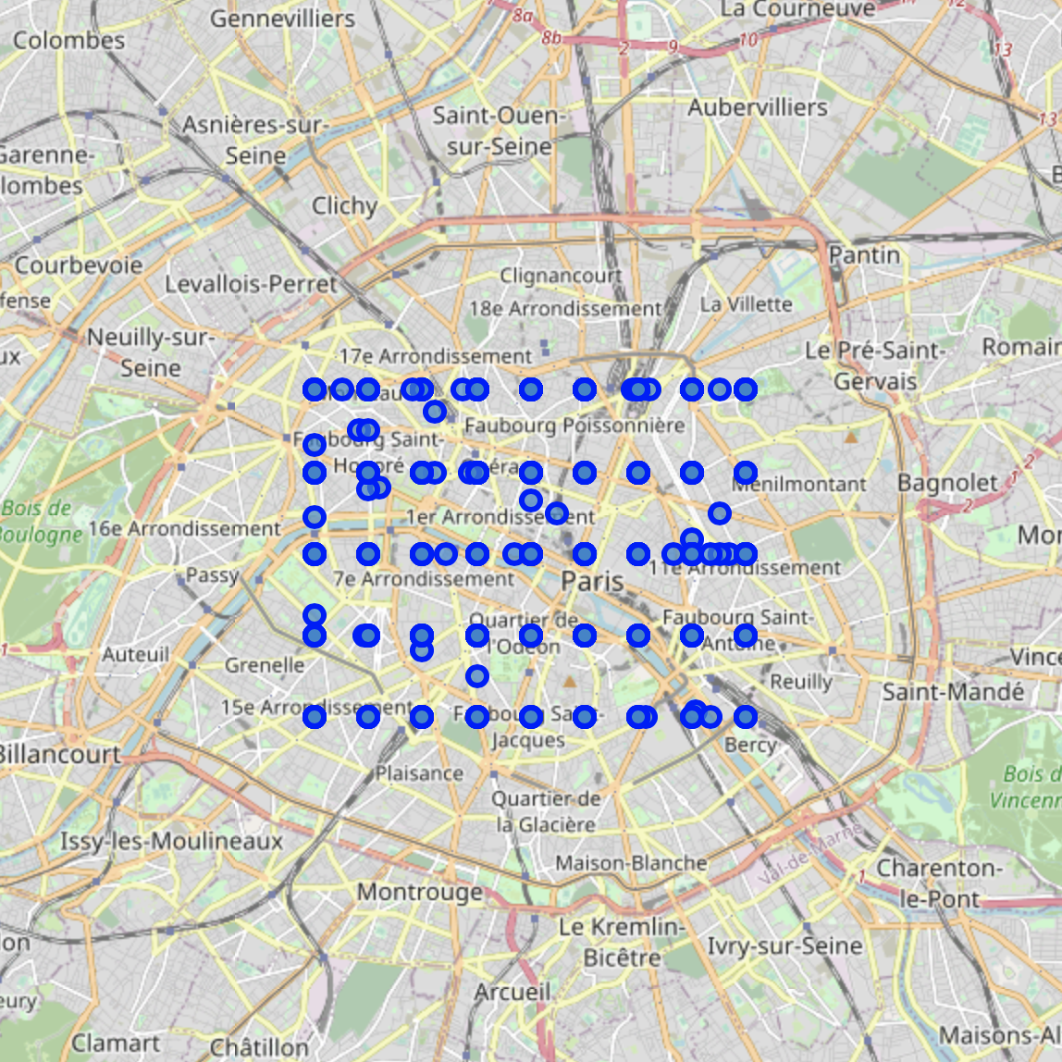
Foursquare API and Folium
The geographical coordinate of Paris are:
Latitude: 48.8566969 Longitude: 2.3514616.
Using Folium Map stations gained before are shown on the map/

Slide 6
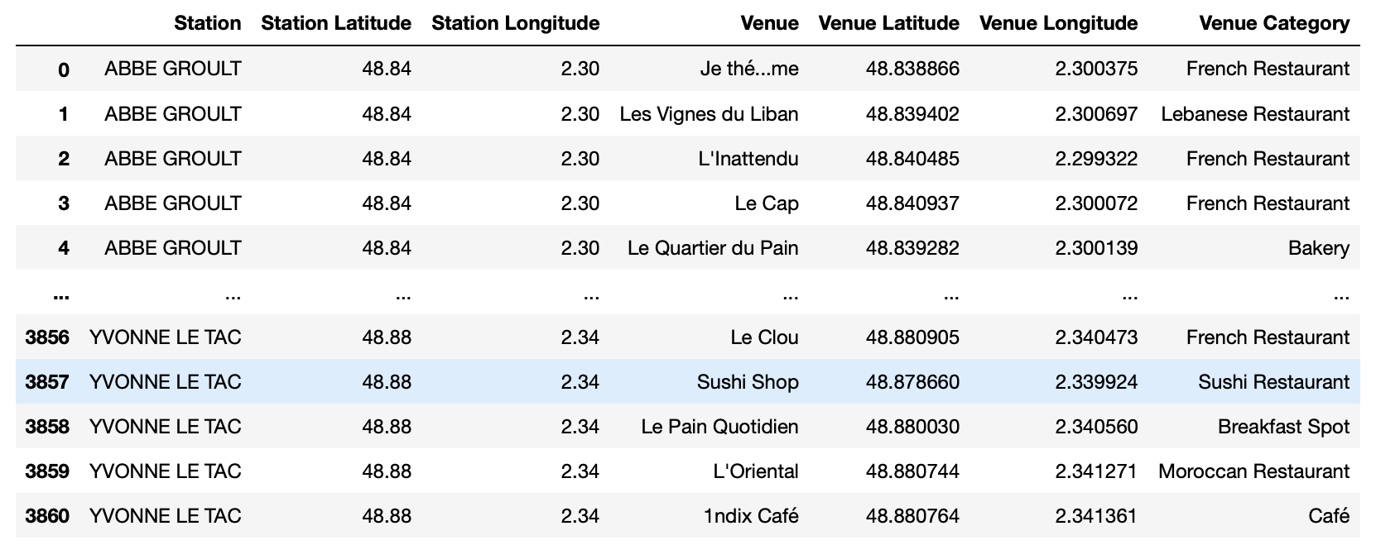
Foursquare API
CLIENT_ID = Foursquare ID
CLIENT_SECRET = Foursquare Secret
VERSION = ‘20200310’
LIMIT = 50
Radius = 150
categoryId = for food we use
‘4d4b7105d754a06374d81259’
3860 call results

Slide 7
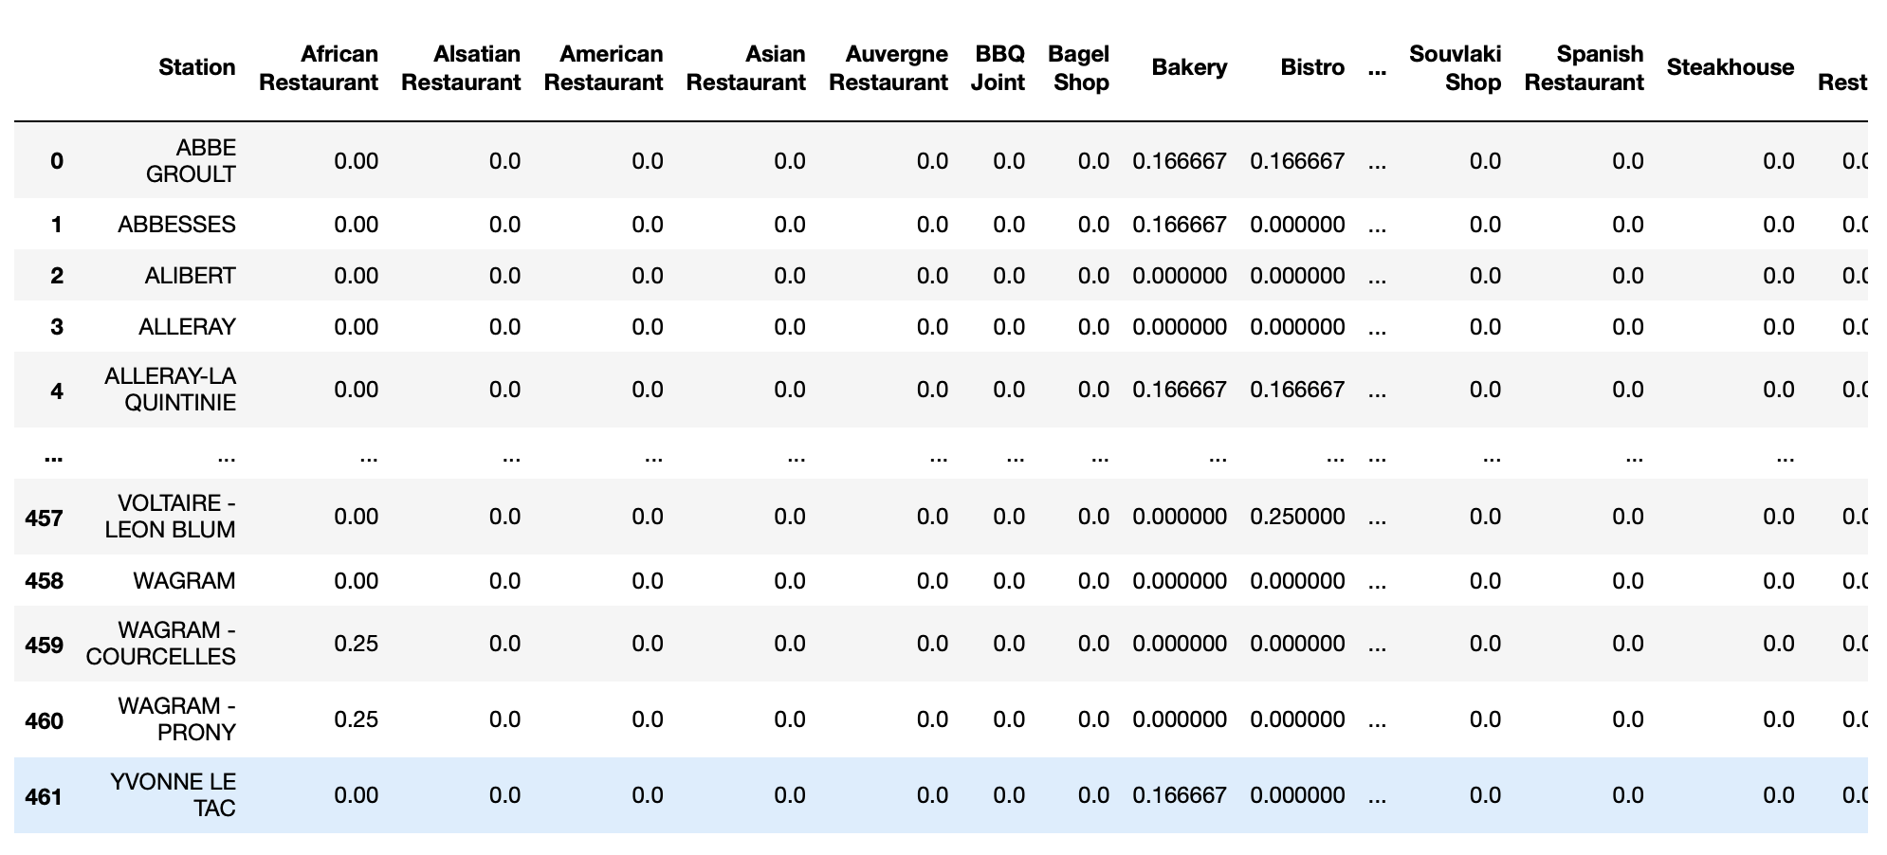
Dataset Preparation
Locations are located close to each other, so some venues were categorized for multiple stations.
Checking ‘Venue’, ‘Venue Latitude’ and ‘Venue Longitude’ columns, duplications were removed.
It reduced the number of rows to 481, and pivot table created.

Slide 8
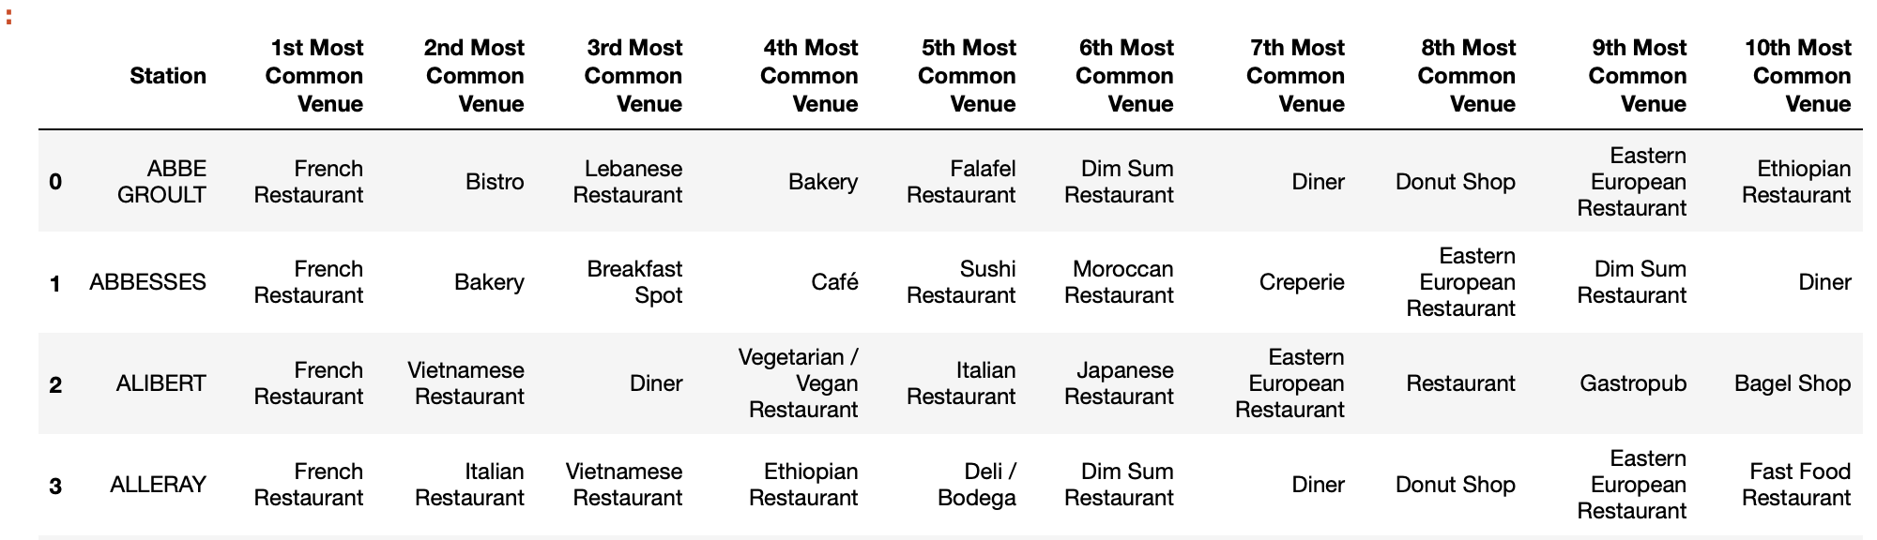
Most Common Venues for Stations
From pivot table demonstrated above, for each station only 10 most common venue categorized were chosen using coefficients (values) in that pivot table.

Slide 9
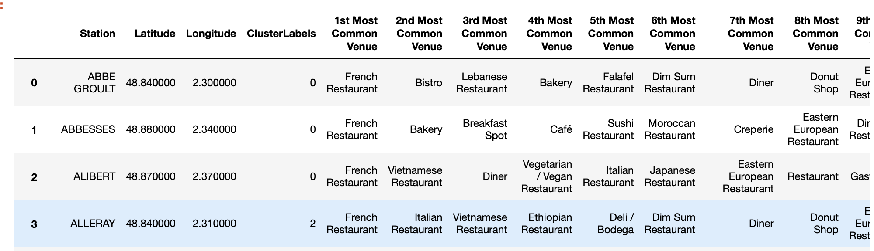
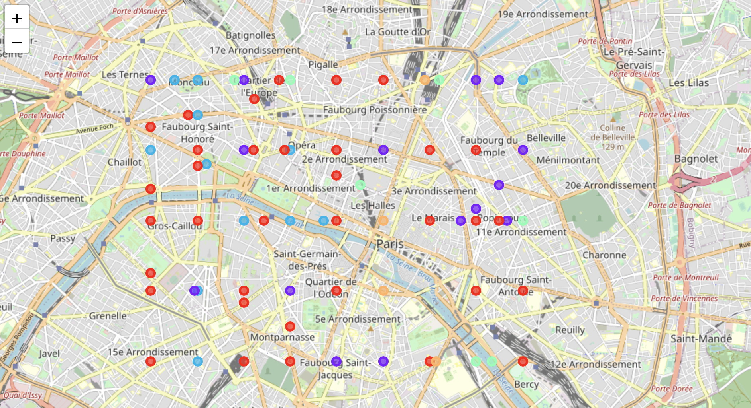
Clustering
Most popular unsupervised learning K-means algorithm was used to cluster stations.
5 clusters with similar to each other in terms of venue types located nearby were created.
Red color – Cluster 0
Violet color – Cluster 1
Blue color – Cluster 2
Green color – Cluster 3
Orange color – Cluster 4

Slide 10
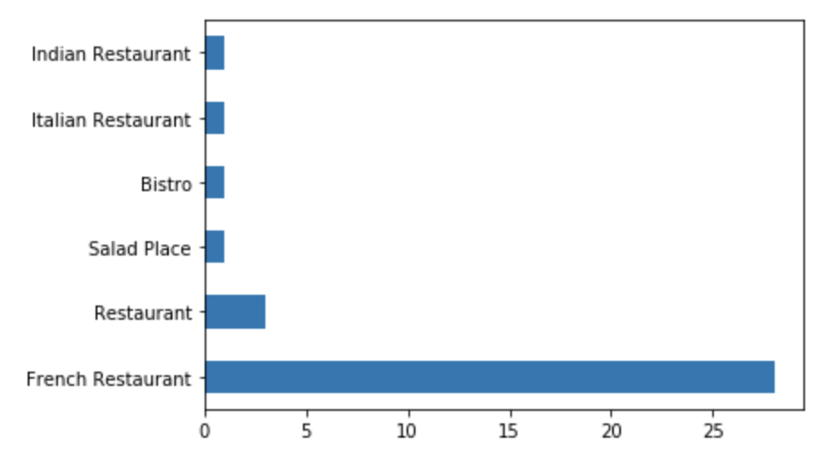
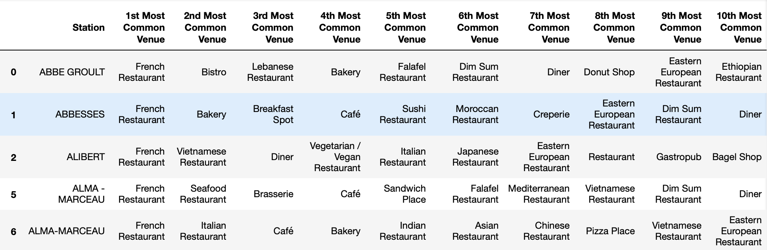
Clusters
Cluster 0: Total number – 35
1st Most Common Venues
As it can be seen from the table and figure above, this cluster is
mainly associated with French Restaurant.

Slide 11
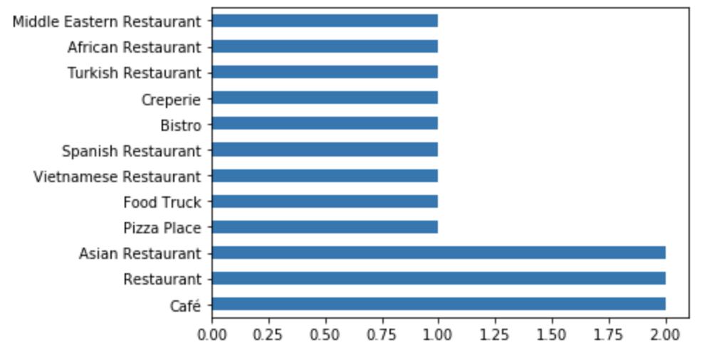
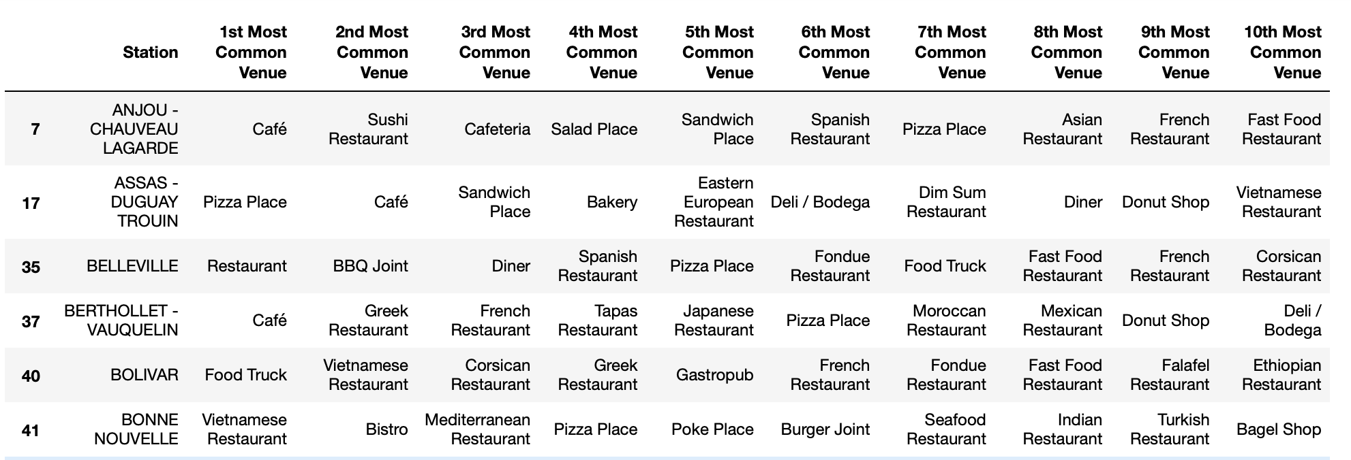
Clusters
Cluster 1: Total number – 15
1st Most Common Venues
In this cluster, there are no specific venue category. Different cuisines are
presented in this cluster, however some pattern for eastern
and African restaurants can be noticed.

Slide 12
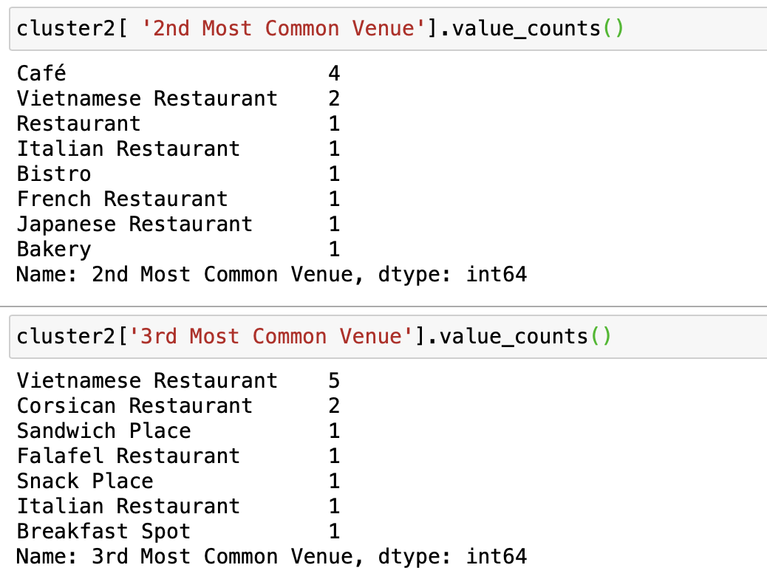
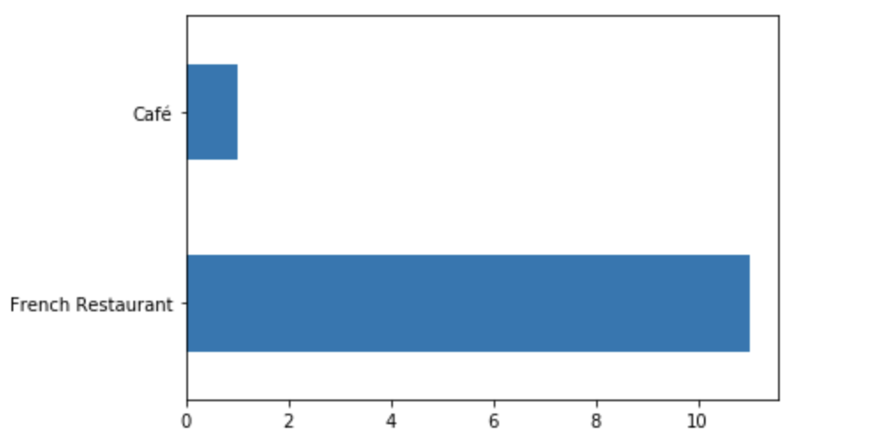
Clusters
Cluster 2: Total number – 12
1st Most Common Venues
Here we can see that French restaurants are common in this cluster as in cluster 0.
So, to get better understanding of difference, cluster 2 was deeper examined.
Counting 2nd and 3rd most common venues demonstrated that along with French restaurants,
Vietnamese restaurants are also popular in this cluster.

Slide 13
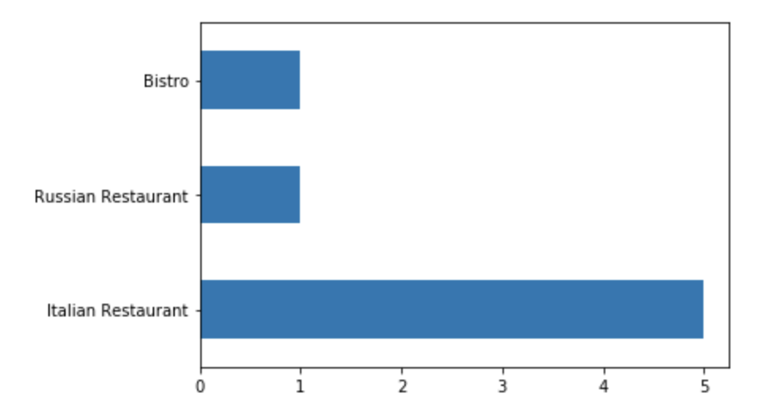
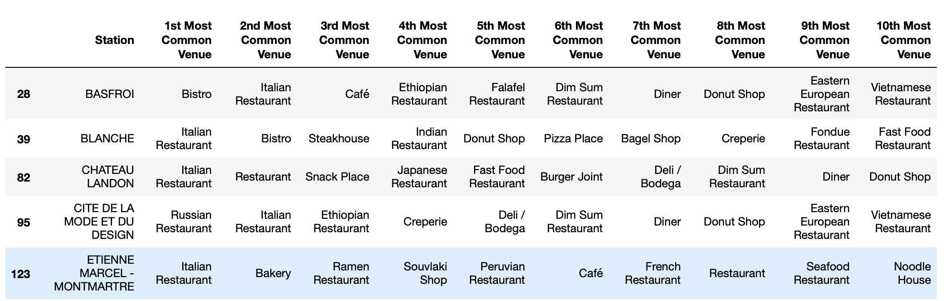
Clusters
Cluster 3: Total number – 7
1st Most Common Venues
Cluster 3 is place where Italian restaurants are densely concentrated. As shown on the table
and figure above stations in this cluster, mostly have 1st most common
venue – Italian Restaurant. Even only two exceptions have Italian restaurants
as 2nd most common venue.

Slide 14
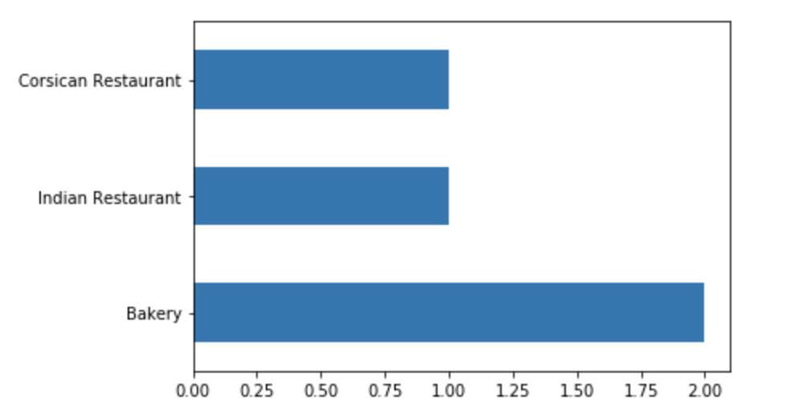
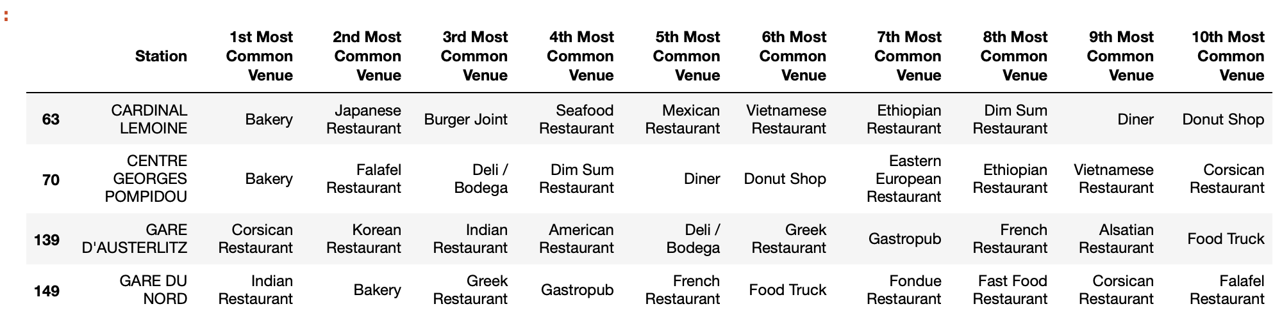
Clusters
Cluster 4: Total number – 4
1st Most Common Venues
Table 9 better describes the profile of this cluster.
Cluster 4 is a mix of Bakeries and eastern cuisines (Japanese, Chinese and Indian).

Slide 15
Conclusion
Choose location in cluster 3, if it is close to italian district.
Other than cluster 3, south-west part of the city where no clusters of Italian restaurants.

